Slide 1
Introduction
PDF is a widely used format for sharing documents. In this course we will take a look at the types of PDF documents and the methods you have at your disposal when trying to extract data from a PDF document. We will also take a look at the anchor base functionality which is used when dealing with unstable selectors.
Learning Objectives
Install the UiPath PDF activities package
Extract large text segments from PDF using the Read PDF activity, the Read PDF with OCR activity and the Screen Scraping wizard
Extract a single piece of information from a PDF document
Use selectors to extract fluctuating values from multiple files with the same layout
Use the Anchor Base activity to extract fluctuating values from a series of PDF files with the same structure.

Slide 2
Extracting Data from PDF Using Methods
Get PDF Text
Get PDF Text with OCR
Screenscraping

Slide 3
PDF Automation - Practice 1
Consider a native PDF document with dynamic information like the one attached. Use anchor base automation to get the DATE and the name from the BILL TO values from the invoice.

Slide 4
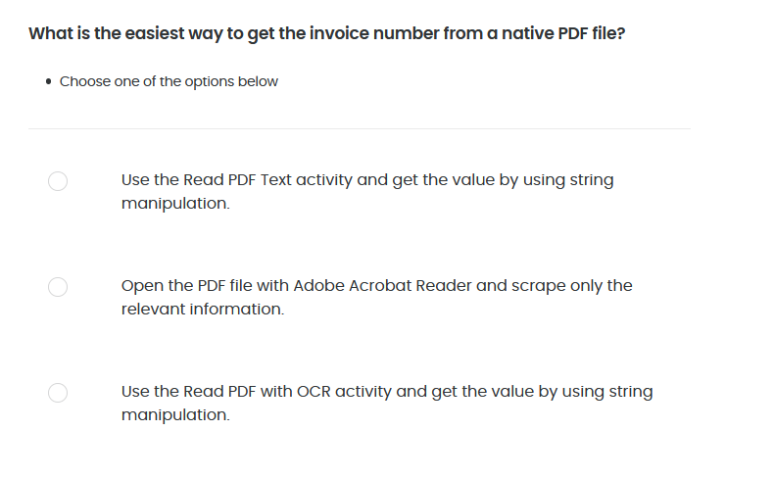
Quiz 01/05

Slide 5
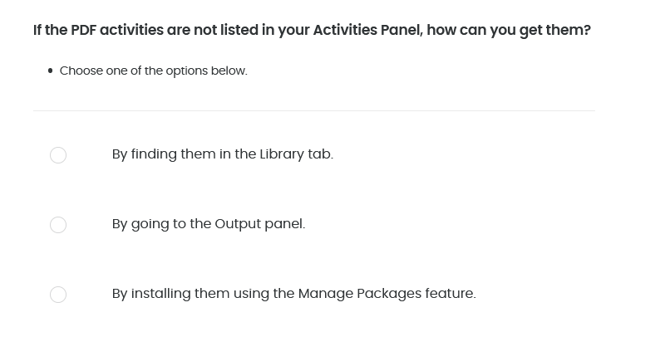
Quiz 02/05

Slide 6
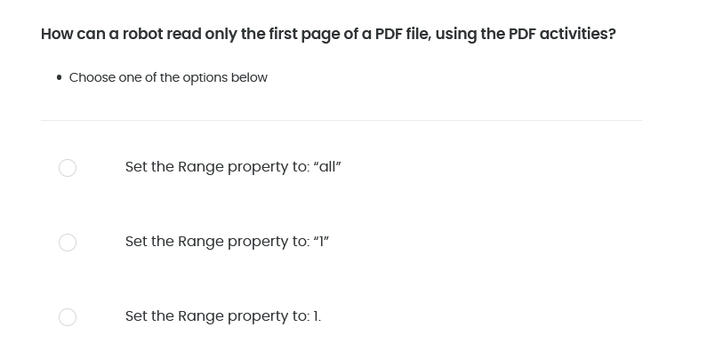
Quiz 03/05

Slide 7
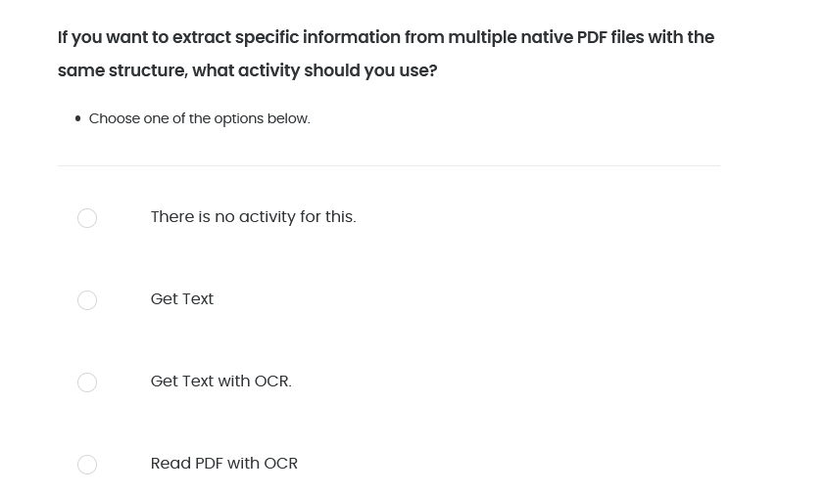
Quiz 04/05

Slide 8
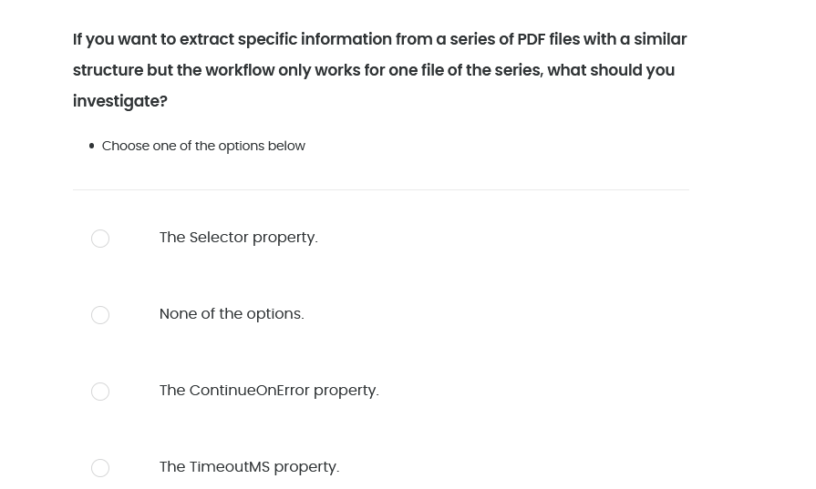
Quiz 05/05

